Slide 1
Home Credit Default Risk Analysis Vignesh Ramaswamy Balasundaram

Slide 2
PROBLEM STATEMENT
Background:
Home Credit provides loans to people with limited credit history.
Traditional credit scoring doesn't work well for such cases.
Goal: Build a more inclusive and accurate credit risk model.
Objective:
Predict the likelihood of a loan applicant defaulting using diverse financial, demographic, and credit history data.

Slide 3
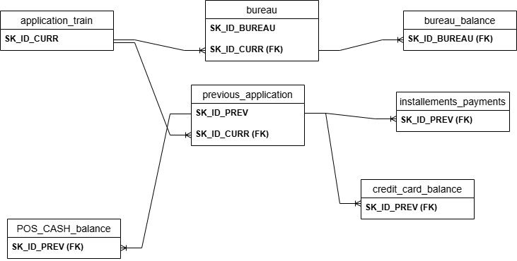
ER DIAGRAM

Slide 4
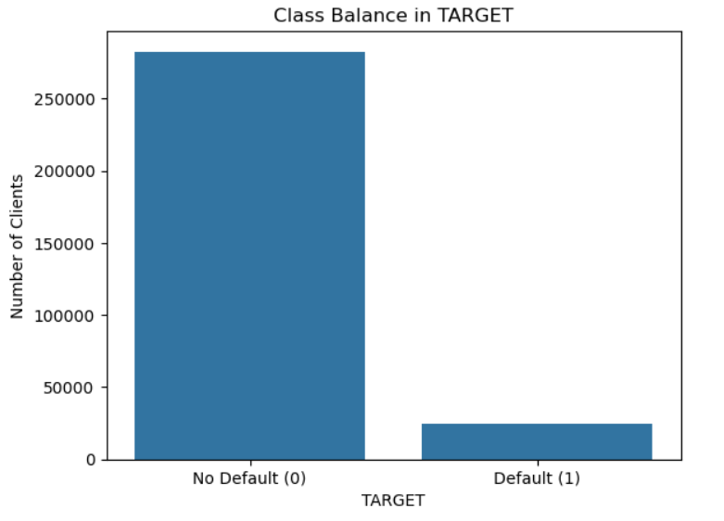
EXPLORATORY DATA ANALYSIS
TARGET VARIABLE DISTRIBUTION
We can see from the graph that the class distribution is highly skewed.
Just 8% of the training data has the default class samples.
This means we cannot use metrics like accuracy and we have to use other robust metrics like precision, recall and AUC scores.
Stratified splitting of the data also has to be done to ensure proportional distribution in training and test sets.

Slide 5
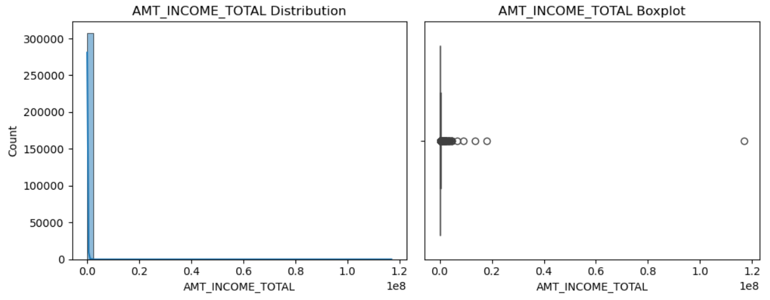
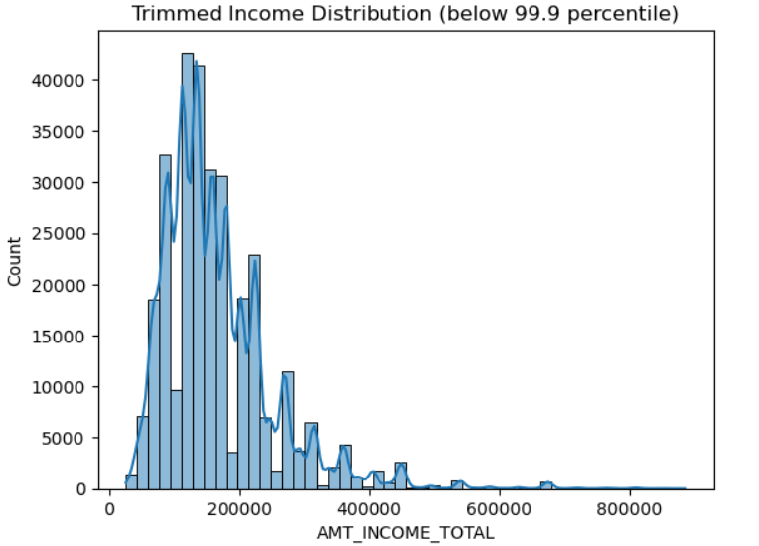
EXPLORATORY DATA ANALYSIS
UNIVARIATE ANALYSIS
1) INCOME DISTRIBUTION

Slide 6
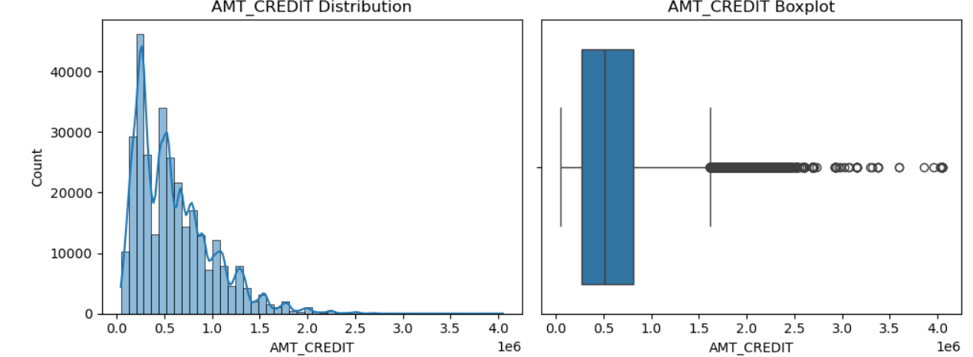
EXPLORATORY DATA ANALYSIS
UNIVARIATE ANALYSIS
2) CREDIT DISTRIBUTION

Slide 7
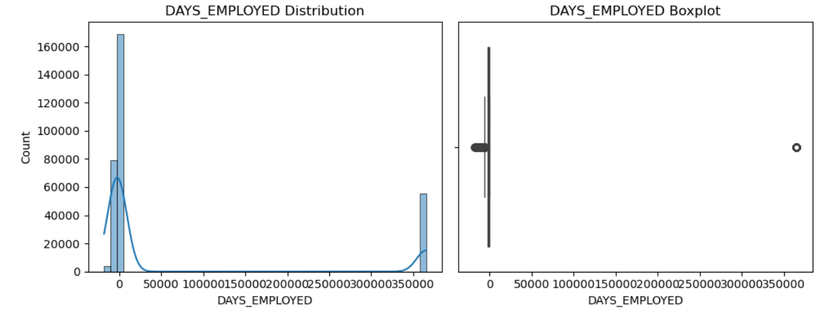
EXPLORATORY DATA ANALYSIS
UNIVARIATE ANALYSIS
3) DAYS EMPLOYED DISTRIBUTION
Days Employed has a massive spike at 350000 days(~ 1000 years).
This is not realistic and it mostly indicates a placeholder for people who are unemployed.
I have replaced this value as nan and created a new binary variable feature indicating employment of a person.

Slide 8
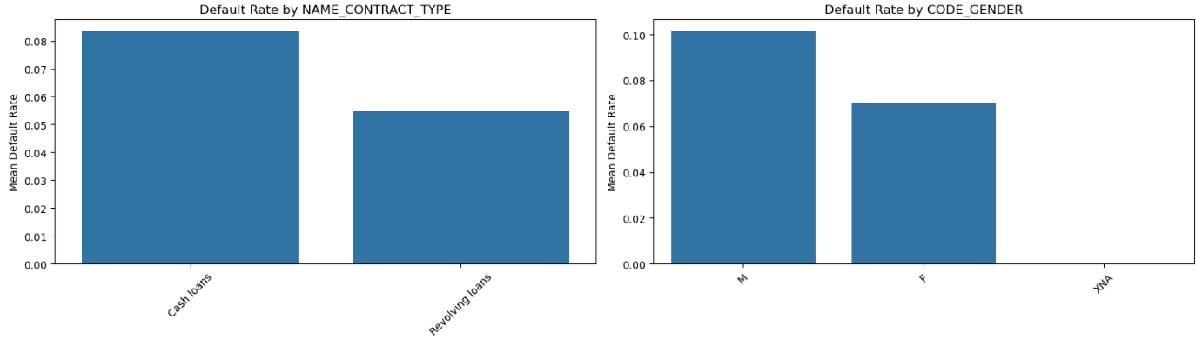
EXPLORATORY DATA ANALYSIS
BIVARIATE ANALYSIS
Contract Type and Gender

Slide 9
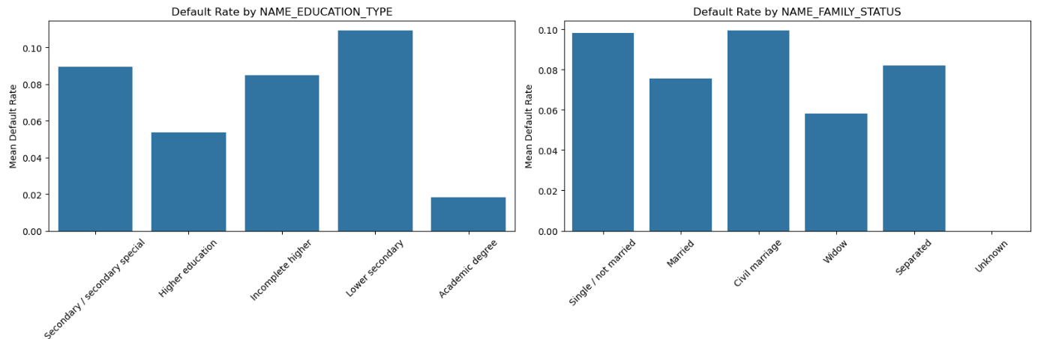
EXPLORATORY DATA ANALYSIS
BIVARIATE ANALYSIS
Education and Family Status

Slide 10
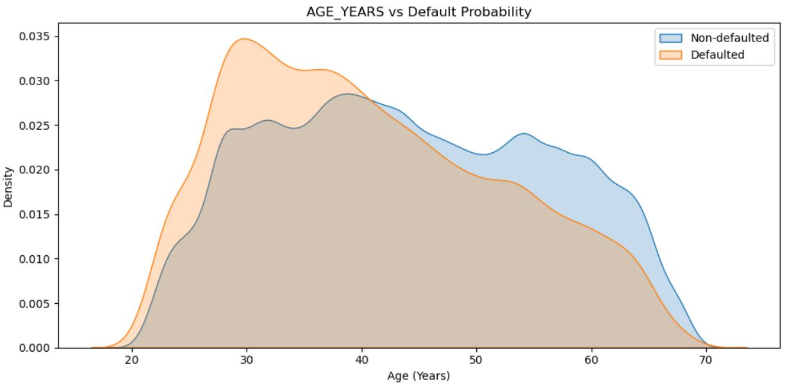
EXPLORATORY DATA ANALYSIS
BIVARIATE ANALYSIS
How does Age affect default rate?

Slide 11
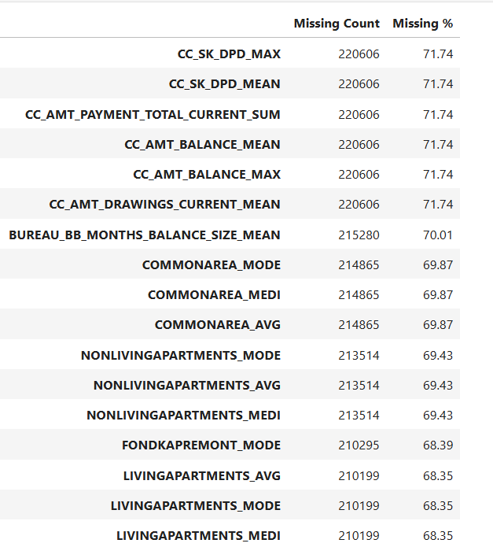
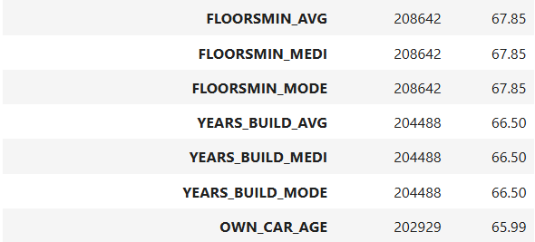
DATA PREPROCESSING
DROP FEATURES
After aggregating and merging all auxiliary tables (e.g., bureau, previous_application, etc.) with the main training dataset, we obtained a total of 158 features.
Out of these, 24 features had more than 60% missing values.
Since imputing features with such high missingness may introduce noise and bias, we dropped them from the dataset.
After dropping these columns, we retained 134 features for model training.

Slide 12
DATA PREPROCESSING IMPUTATION AND ENCODING
1) For the remaining features with missing values:
Numerical columns were imputed using the median.
Categorical columns were imputed using the mode.
2) There were a total of 15 categorical features:
Features with 2 unique values were label encoded.
Features with 3 to 9 unique categories were one-hot encoded to avoid high dimensionality.
3) After completing all preprocessing steps including imputation, encoding, and dropping high-missingness features, the final dataset contains 168 features.

Slide 13
DATA PREPROCESSING FEATURE ENGINEERING
To enhance model interpretability and capture meaningful relationships, the following derived features were engineered:
CREDIT_INCOME_RATIO
= AMT_CREDIT / AMT_INCOME_TOTAL
- Measures how much credit the applicant has taken relative to their income.
ANNUITY_INCOME_RATIO
= AMT_ANNUITY / AMT_INCOME_TOTAL
- Indicates the burden of annuity payments on income.
ANNUITY_CREDIT_RATIO
= AMT_ANNUITY / AMT_CREDIT
- Represents the proportion of credit paid annually.
DAYS_BIRTH
- Transformed from negative to positive values for better readability and interpretation.
EMPLOYED_PERCENT
= DAYS_EMPLOYED_CLEAN / DAYS_BIRTH
- Estimates the fraction of life the applicant has been employed.

Slide 14
MODELING LOGISTIC REGRESSION
Training Process
1) Standardization :
Applied StandardScaler to normalize all features to zero mean and unit variance, as logistic regression assumes features are on the same scale for optimal convergence and stability.
2) Cross-Validation:
Used Stratified 5-Fold Cross-Validation to maintain class distribution across folds.
Collected Out-of-Fold (OOF) predictions on the held-out fold.
3) Performance Evaluation:
Finally computed metrics like precision, recall, AUC scores for all the OOF predictions.

Slide 15
MODELING LOGISTIC REGRESSION
OOF Results
AUC_SCORE | 0.75590
Precision | 0.48471
Recall | 0.01660
F1-score | 0.03209
Submission Results
Public Score | 0.73997
Private Score | 0.73513

Slide 16
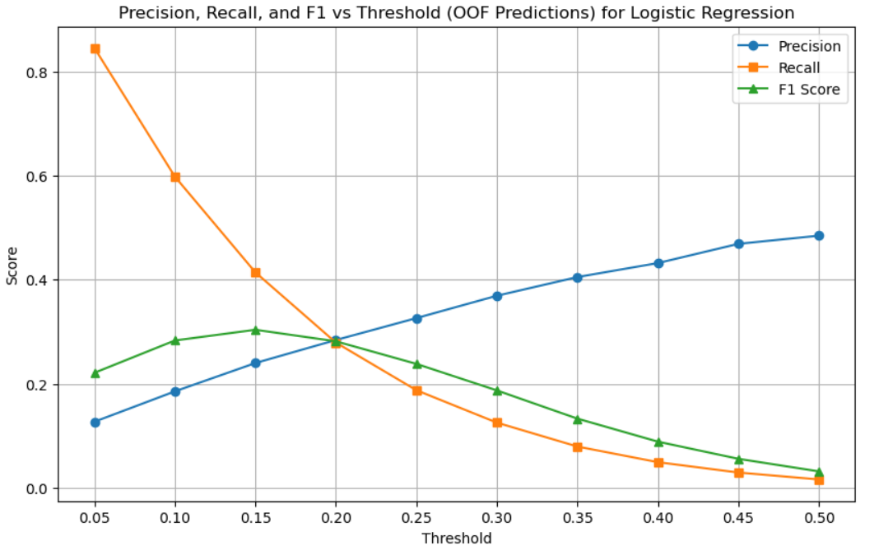
MODELING LOGISTIC REGRESSION
Results For Different Thresholds

Slide 17
MODELING RANDOM FOREST
Training Process
1) Randomized Search :
First performed random search cv to estimate the optimal hyperparameters for random forest model.
2) Cross-Validation:
Used Stratified 5-Fold Cross-Validation with the best parameters obtained from random search.
Collected Out-of-Fold (OOF) predictions on the held-out fold.
3) Performance Evaluation:
Finally computed metrics like precision, recall, AUC scores for all the OOF predictions.

Slide 18
MODELING RANDOM FOREST
OOF Results
AUC_SCORE | 0.73979
Precision | 0.17648
Recall | 0.5839
F1-score | 0.271
Submission Results
Public Score | 0.7340
Private Score | 0.73154

Slide 19
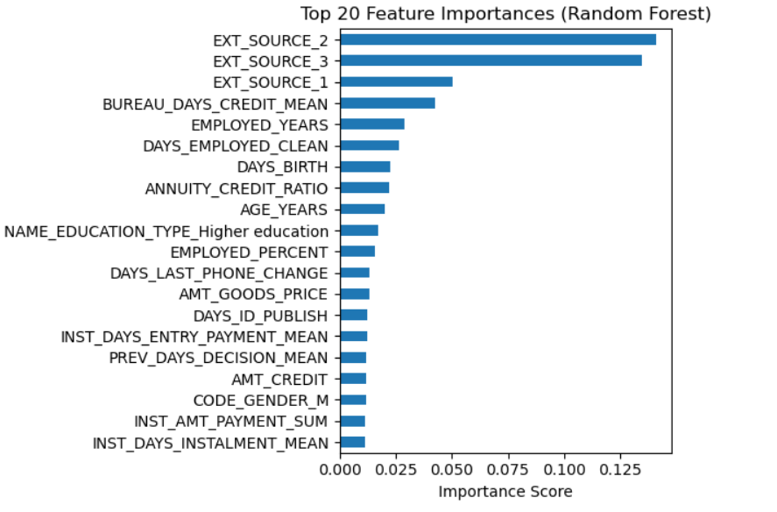
MODELING RANDOM FOREST

Slide 20
MODELING RANDOM FOREST TOP 50 FEATURES
OOF Results
AUC_SCORE | 0.74844
Precision | 0.17837
Recall | 0.58792
F1-score | 0.27370
Submission Results
Public Score | 0.73951
Private Score | 0.73714

Slide 21
MODELING LIGHTGBM WITH TOP50 FEATURES
Training Process
Feature Selection:
Collected top 50 features from random forest based on feature importances.
2) Cross-Validation:
Used Stratified 5-Fold Cross-Validation to maintain class distribution across folds.
Collected Out-of-Fold (OOF) predictions on the held-out fold.
3) Performance Evaluation:
Finally computed metrics like precision, recall, AUC scores for all the OOF predictions.

Slide 22
MODELING LIGHTGBM WITH TOP50 FEATURES
OOF Results
AUC_SCORE | 0.77519
Precision | 0.18269
Recall | 0.65297
F1-score | 0.28550
Submission Results
Public Score | 0.76567
Private Score | 0.76650

Slide 23
MODELING LIGHTGBM USING OPTUNA WITH TOP50 FEATURES
Submission Results
Public Score | 0.76966
Private Score | 0.76426

Slide 24
MODELING LIGHTGBM USING OPTUNA WITH ALL FEATURES
Submission Results
Public Score | 0.76540
Private Score | 0.76718

Slide 25
CONCLUSION
Final Model Performance
Best model achieved AUC = 0.76966 on the public leaderboard.
Corresponding private leaderboard AUC = 0.76426, evaluated on 80% of the hidden test data.
The private score determines the final ranking, ensuring generalization beyond just public test data
2) Key Insights
Feature selection using Random Forest significantly improved generalization.
More features did not improve performance but simpler, cleaner feature sets worked better.
LightGBM with stratified CV and early stopping provided stable and reliable performance.

Slide 26
THANK YOU

